Slide 1
Biometric Finger Veins Authentication using Deep Learning Algorithm
TEAM MEMBERS:
Nivedhitaa Ravichandran (211417104172)
Pratisha B (211417104195)
Preethi M (211417104198)
Guide Details:
Mrs. V. Sathya Preiya
Associate Professor
DOMAIN:
ARTIFICIAL INTELLIGENCE

Slide 2
INTRODUCTION
Finger vein recognition is a method that specifies an individual using the vein pattern inside one’s fingers.
_{Unique}
_{Less intrusive.}
Extremely difficult to read or steal.
_{Higher acceptance rate.}

Slide 3
Literature Survey
Year of Publishing | Author Name | Title of the Paper | Merits | Demerits
2019 | Takao Murakami , Ryo Fujita, Tetsushi Ohki Link: https://ieeexplore.ieee.org/abstract/document/8679987 | Cancelable Permutation-Based Indexing for Secure and Efficient Biometric Identification | Filters are adjusted automatically to extract the most useful information Network performance are assessed for each topologies Eliminate confusing variables | Difficult to form a pattern in the dataset to be applied Model does not use less parameters Existing loss can easily lose important information
2018 | Raghavendra Ramachandra, Kiran Raja, Sushma Venkatesh and Christoph Busch Link: https://ieeexplore.ieee.org/document/8672597 | Design and Development of low-cost Sensor to capture ventral and dorsal Finger-vein for Biometric Authentication | More accurate the detection results Performance of the classifier improved significantly Identify and detect with the help of patterns created | Unable to resolve the problem when probability is half by half No better performance as a baseline.

Slide 4
Literature Survey
Year of Publishing | Author Name | Title of the Paper | Merits | Demerits
2018 | Wenming Yang, Zhiquan Chen, Chuan Qin, Qingmin Liao Link: https://ieeexplore.ieee.org/document/8374822 | Trimmed Weber Representation and Cross Section Asymmetrical Coding for Human Identification using Finger Images | Equalization ensures that the resulting histogram is smooth Increase the contrast of the main components Clip Limit parameter increases | Does not Implicitly encoding disease label, and location bounding box Does not Exploiting the mutual relationship between labels and the locations of diseases
2017 | Lu Yang, Gongping Yang, Xiaoming Xi, Xianjing Meng, Chunyun Zhang and Yilong Yin Link: https://ieeexplore.ieee.org/document/7993012 | Tri-branch Vein Structure Assisted Finger Vein Recognition | Improve the recognition performance of the template matching Supports fused with the whole vein pattern by a user-specific threshold based filter framework Developed based on the imaging characteristic of finger vein that the gray value of vein point | Performance remains unsatisfactory owing to defective vein networks and weak matching Neglect of deep analysis of the vein anatomy structure

Slide 5
Literature Survey
Year of Publishing | Author Name | Title of the Paper | Merits | Demerits
2017 | Lu Yang, Gongping Yang, Yilong Yin, and Xiaoming Xi Link: https://ieeexplore.ieee.org/document/7882665 | Finger Vein Recognition with Anatomy Structure Analysis | Anatomy structure analysis-based vein extraction Extracted by the orientation map-guided curvature based on the valley- or half valley-shaped cross sectional profile Thinned and refined to obtain a reliable vein network | Accurate evaluation of joint damage is low Does not improve the assessment sensitivity in the early stage Lead to the generation of bad candidate proposals
2016 | Xinwei Qiu, Wenxiong Kang, Senping Tian, Wei Jia, Zhixing Huang Link: https://ieeexplore.ieee.org/document/8049353 | Finger Vein Presentation Attack Detection Using Total Variation Decomposition | Efficient and robust method for detecting presentation attacks Detects degrees of blurriness and the noise distribution Encode both structure and noise information in the decomposed components | Does not support pattern based finger vein recognition Computational cost in training the model is high Does not bifurcation point of vein pattern vary largely between the imposter images

Slide 6
Problem Statement
Works by utilizing the differences of vein patterns for personal identification.
Compares the vein pattern with existing pattern.
Combination of hardware design and software procedures.
Hardware- to capture finger veins.
Software- to use appropriate algorithms for authentication.

Slide 7
Development Environment
Backend Technologies
Python
Numpy
Scikit-learn (Sklearn)
TensorFlow & Keras
Frontend Technologies
Jupyter Notebook

Slide 8
Dataset Used
Size: 80MB
No. of samples used: 65 people’s finger vein data
Source link: http://drfendi.com/2015/12/05/fv-usm-database-download-page/

Slide 9
System Architecture

Slide 10
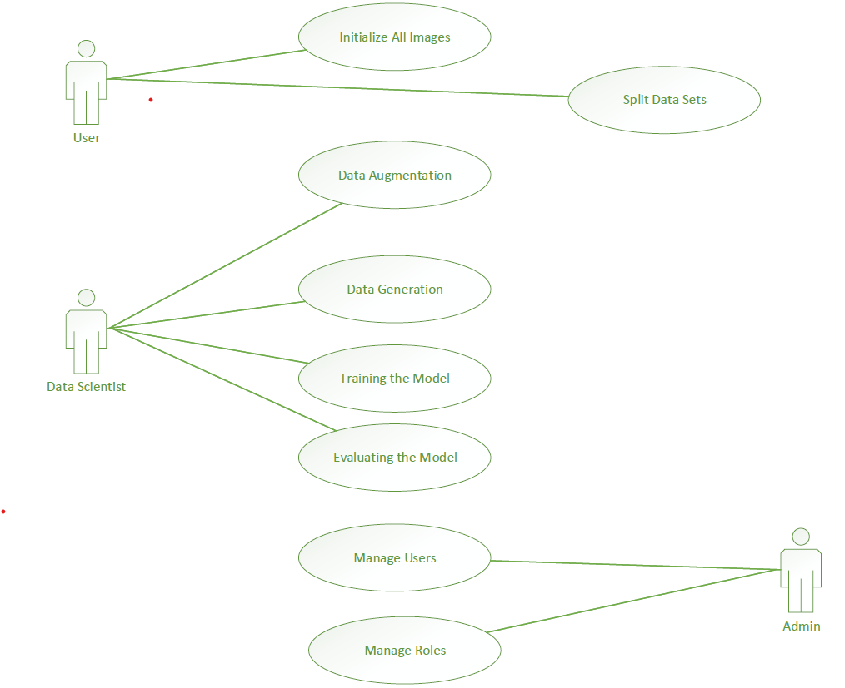
Use Case Diagram

Slide 11
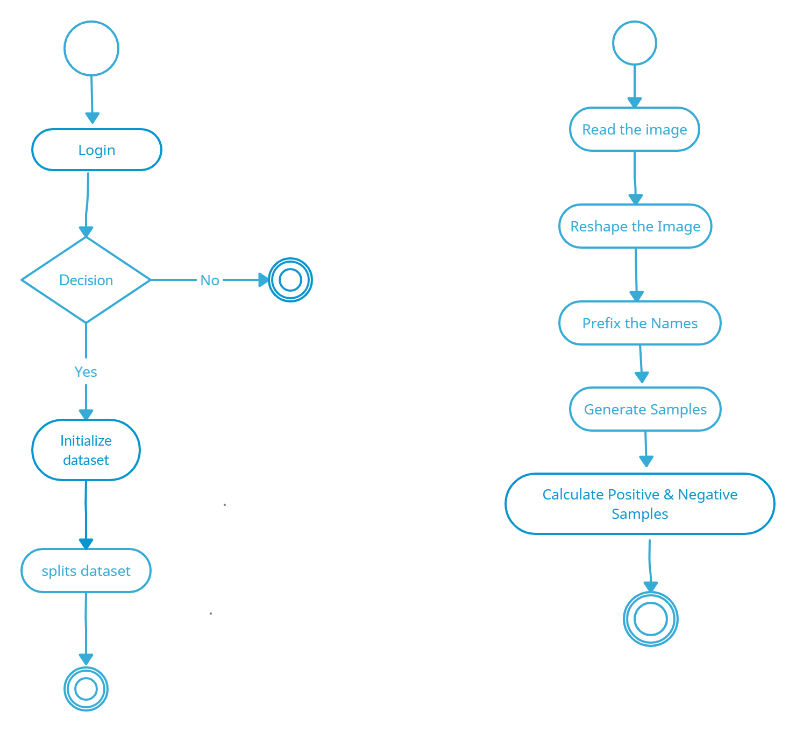
Activity Diagram

Slide 12
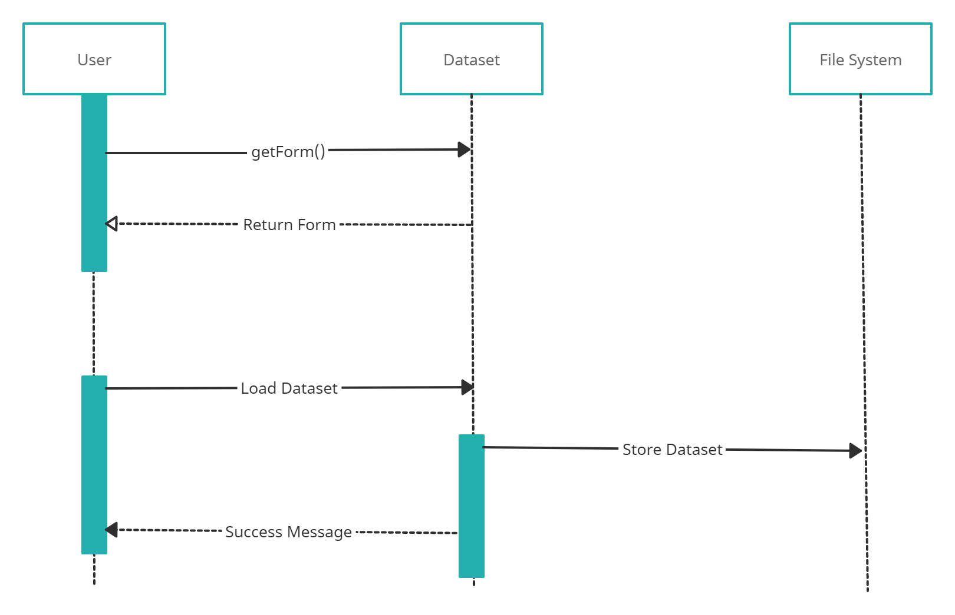
Sequence Diagram

Slide 13
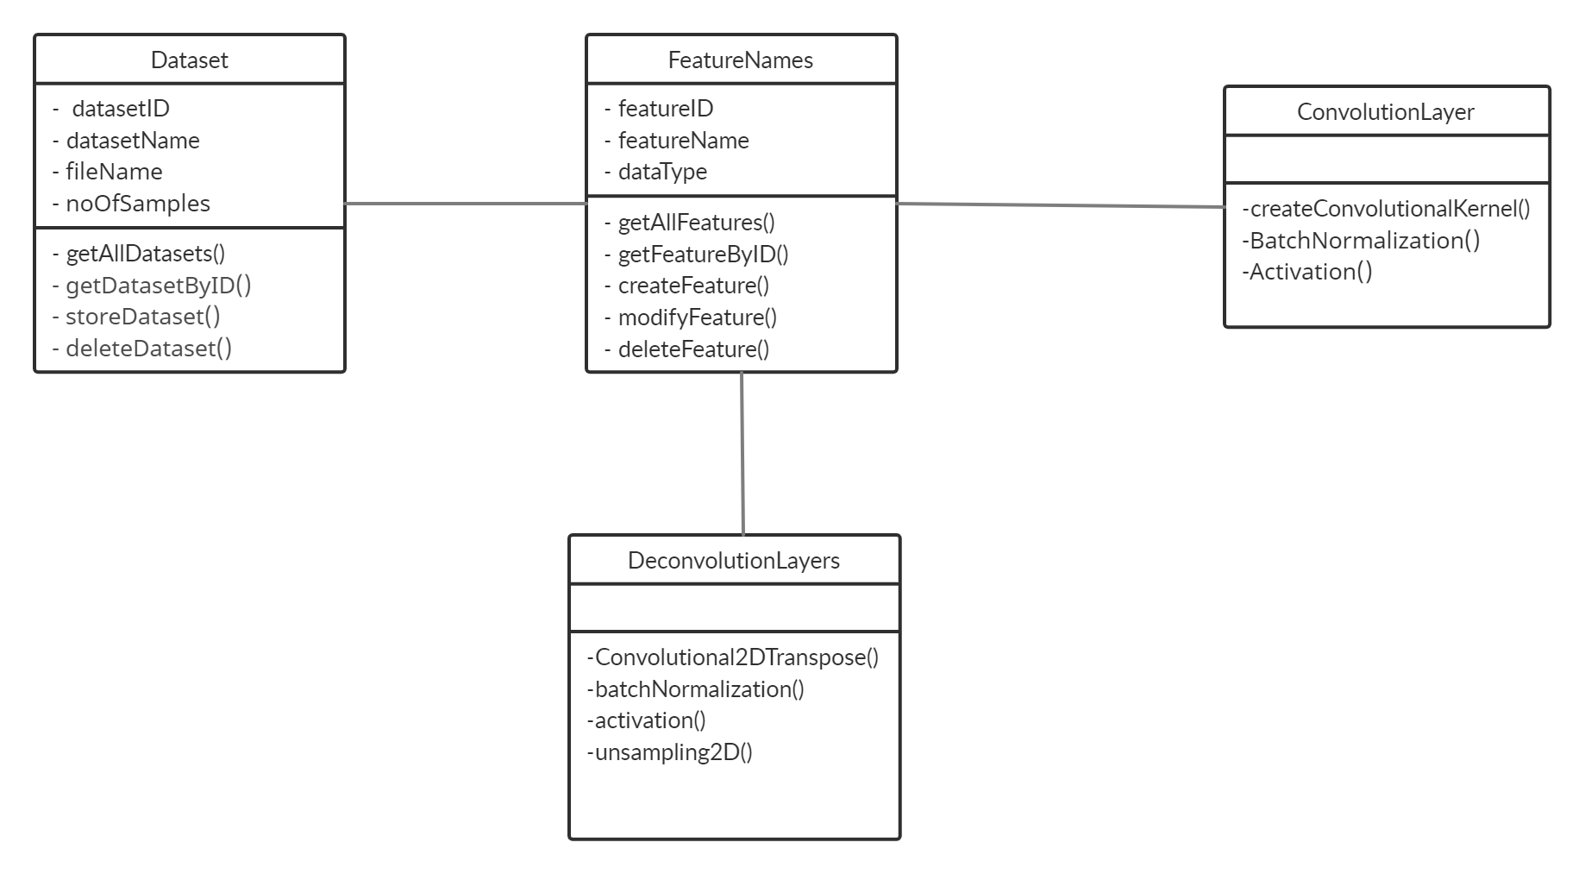
Class Diagram

Slide 14
MODULES Exploratory Data Analysis
Exploratory data analysis is generally cross-classified in two ways.
Non-graphical or graphical.
Univariate or multivariate (usually just bivariate).
Data visualization- to visualize both small and large size data.
Library used- matplotlib

Slide 15
Dataset Processing
The steps involved in data preprocessing are as follows:
Image Sharpening
Threshold Binary
Erosion
Sobel
Scaling
Contouring

Slide 16
Feature Selection
Automatically select features that contribute most to prediction variable.
Removes Overfitting
Improves Accuracy
Reduces Training time

Slide 17
Prediction
Image Data Generator class – used to augment images in real time
Exponential Linear Unit (ELU) activation functions : A single fully-connected layer after the last max pooling.
Batch normalization apply data processing for the hidden layers of the network.
Batch normalization reduces internal covariant shift.

Slide 18
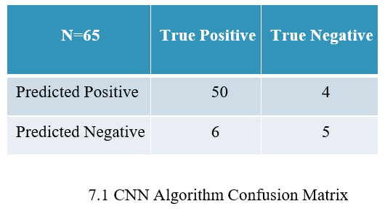
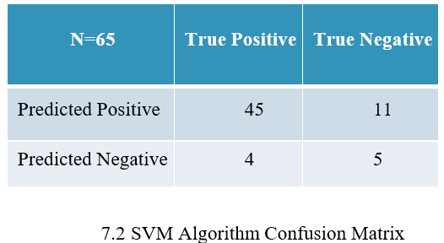
Confusion Matrix

Slide 19
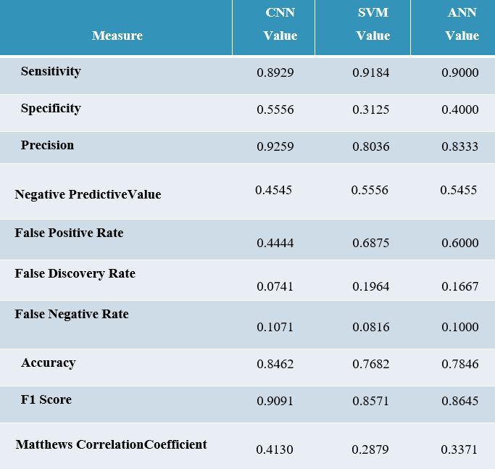
Performance Analysis

Slide 20
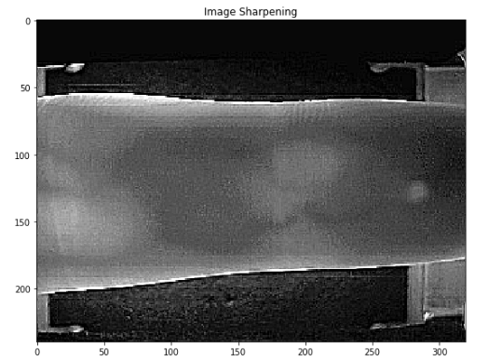
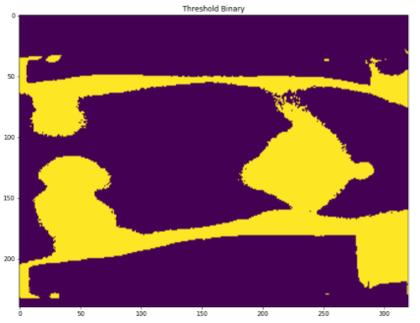
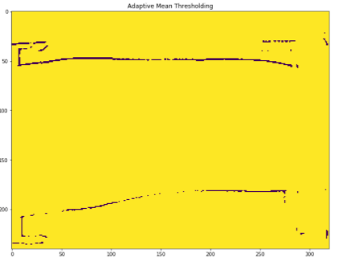
Screenshots

Slide 21
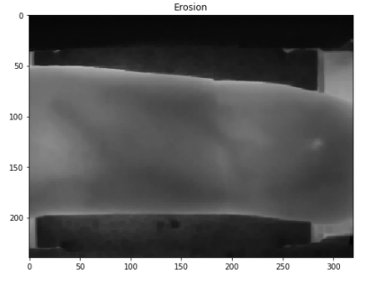
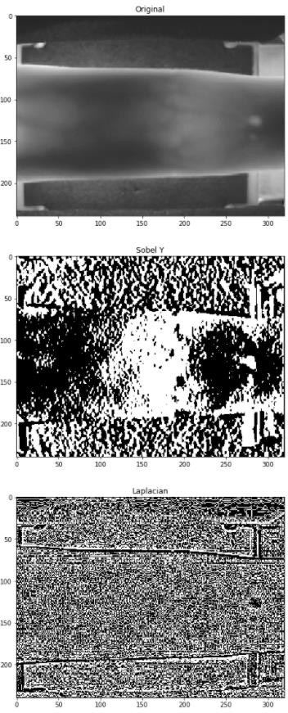
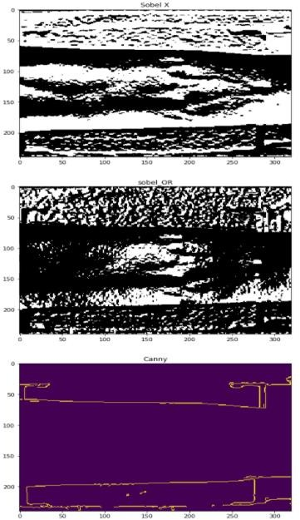
Screenshots

Slide 22
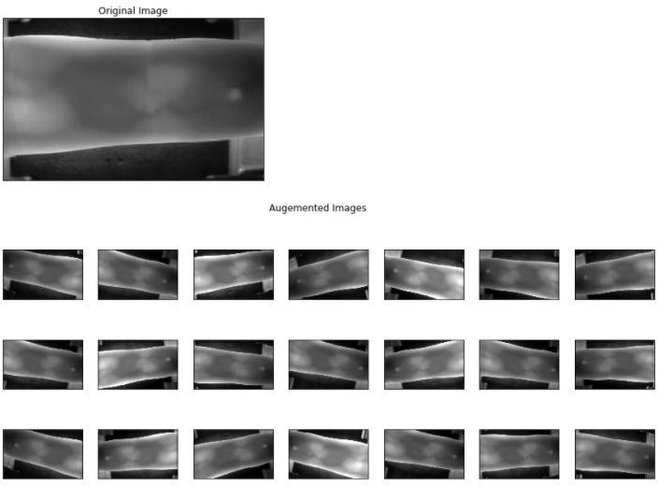
Screenshots

Slide 23
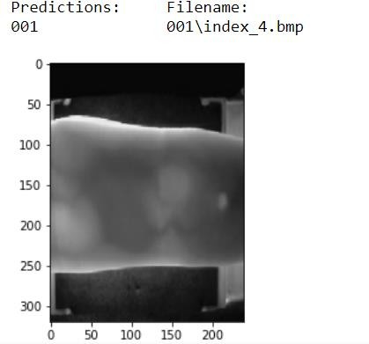
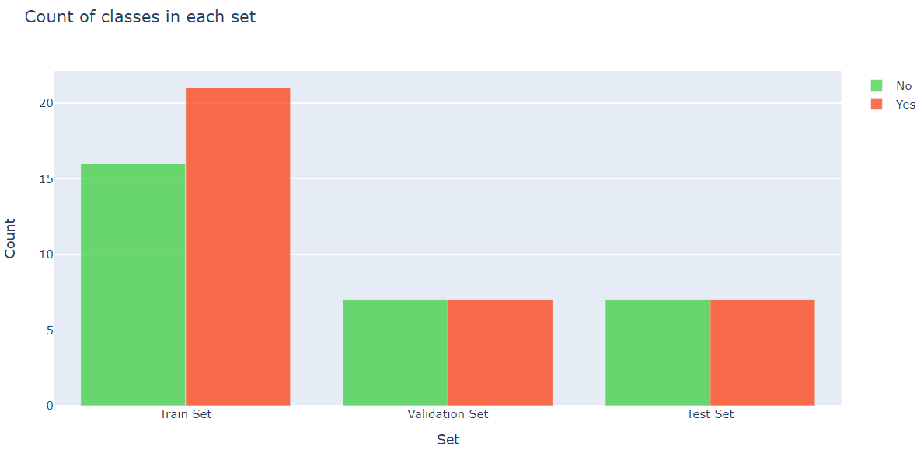
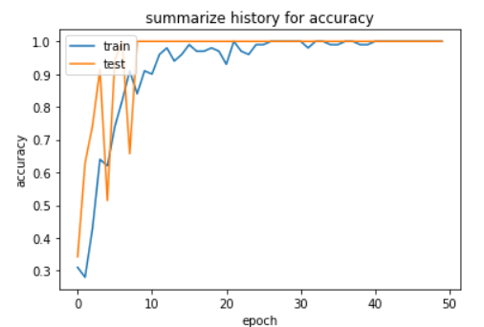
Screenshots

Slide 24
CONCLUSION
Suitable for quantification in the early stage and for use in large cohorts.
More timely with our quantitative measurements than by ordinal scores.
Future research - biometric authentication

Slide 25
REFERENCES
D. De Santos-Sierra, M. F. Arriaga-Gómez, G. Bailador, And C. Sánchez- Ávila, “Low Computational Cost Multilayer Graph- Based Segmentation Algorithms For Hand Recognition On Mobile Phones,” In Proc. Int. Carnahan Conf. Security Technol. (Iccst), Rome, Italy, 2014, Pp. 1–5.
W. Kang And Q. Wu, “Pose-Invariant Hand Shape Recognition Based On Finger Geometry,” Ieee Trans. Syst., Man, Cybern., Syst., Vol. 44, No. 11, Pp. 1510–1521, Nov. 2014.
B. P. Nguyen, W.-L. Tay, And C.-K. Chui, “Robust Biometric Recognition From Palm Depth Images For Gloved Hands,” Ieee Trans. Human–Mach. Syst., Vol. 45, No. 6, Pp. 799–804, Dec. 2015.Morales Et Al., “Synthesis Of Large Scale Hand-Shape Databases For Biometric Applications,” Pattern Recognit. Lett., Vol. 68 , No. 1, Pp. 183–189, 2015.
R. M. Luque-Baena, D. Elizondo, E. López- Rubio, E. J. Palomo, And T. Watson, “Assessment Of Geometric Features For Individual Identification And Verification In Biometric Hand Systems,” Expert Syst. Appl., Vol. 40, No. 9, Pp. 3580–3594, 2013.S. Marcel, M. S. Nixon, And S. Z. Li, Handbook of Biometric Anti-Spoofing: Springer, 2014.
D. Gragnaniello, C. Sansone, And L. Verdoliva, “Iris Liveness Detection For Mobile Devices Based On Local Descriptors,” Pattern Recognition Letters, Vol. 57, Pp. 81-87, 2015.L. Yang, G. Yang,
Y. Yin, And X. Xi, “Finger Vein Recognition With Anatomy Structure Analysis,” Ieee Trans. Circuits Syst. Video. Technol., 2017.

Slide 26
REFERENCES
L. Yang, G. Yang, L. Zhou, And Y. Yin, “Superpixel Based Finger Vein Roi Extraction With Sensor Interoperability,” In Proc. 8th Int. Conf. Biometrics (Icb), Phuket, May. 2015, Pp. 444–451.
L. Yang, G. Yang, Y. Yin, And R. Xiao, “Sliding Window-Based Region Of Interest Extraction For Finger Vein Images,” Sensors, Vol. 13, No. 3, Pp.3799–3815, 2013.
Nalini, K., and L. Jaba Sheela. "A survey on datamining in cyber bullying.” International Journal on Recent and Innovation Trends in Computing and Communication 2.7 (2014): 1865-1869.
Sheela, L. Jaba, and V. Shanthi. "DIMAR- Discovering interesting medical association rules form MRI scans." 2009 6th International Conference on Electrical Engineering/Electronics, Computer, Telecommunications and Information Technology. Vol. 2. IEEE, 2009.
K. B. Raja, R. Raghavendra, And C. Busch, “Video Presentation Attack Detection In Visible Spectrum Iris Recognition Using Magnified Phase Information,” Ieee Transactions On Information Forensics And Security, Vol. 10, No. 10, Pp. 2048-2056, 2015.

Slide 27
THANK YOU

